Slide 1

3. Covariances
Dr. David R. Thompson
Jet Propulsion Laboratory, Imaging Spectroscopy Group

Slide 2
Goals for this module
Recognize the multivariate Gaussian and know its mathematical properties
Estimate well-conditioned covariance matrices from spectroscopic data
Visualize covariance matrices with sampling and marginal distributions

Slide 3
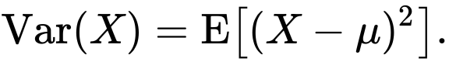
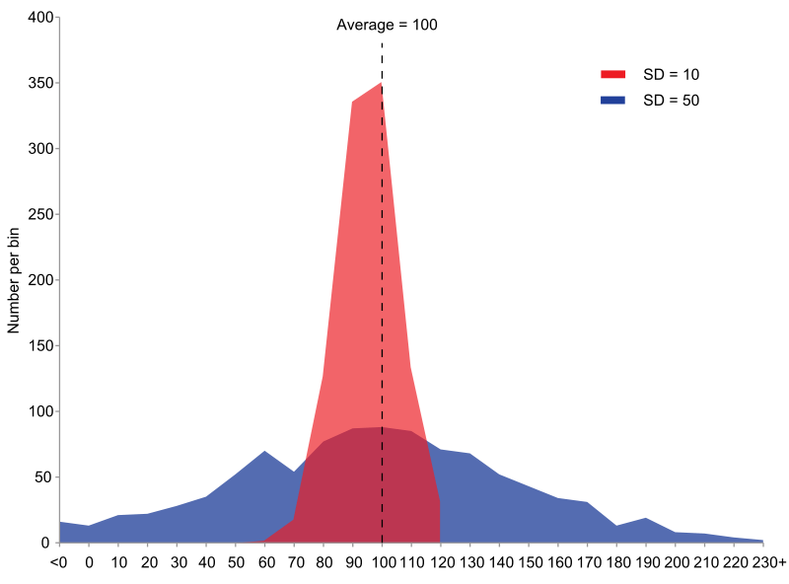
For one variable, the variance describes the spread of the data.
Image: wikimedia

Slide 4
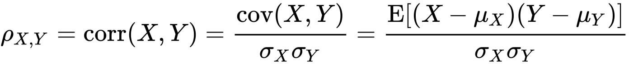
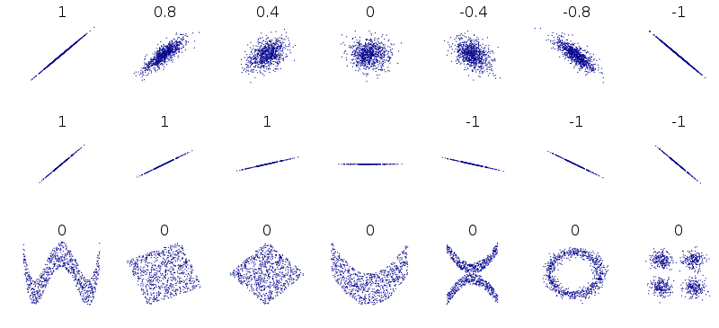
For two variables, the covariance describes the linear relationship.
Normalized, it is the correlation coefficient.
Image: wikimedia

Slide 5
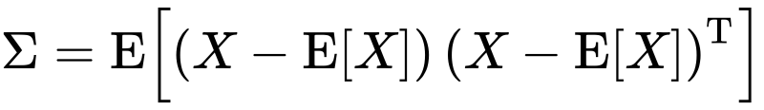

For vector-valued data, the covariance matrix has the covariance between all elements.
Diagonals hold the variance of each variable.
channel 2
$$Σ=\left[\begin{matrix}0.74 & 0.11 \\ 0.11 & 0.17\end{matrix}\right]$$
Off-diagonals describe correlations.
channel 1

Slide 6
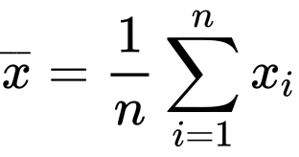
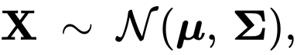
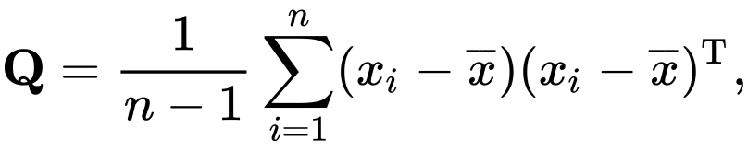
To estimate it from data, start with the mean:
( Note: we also use the symbol )
… defining a “sample covariance”:
Credit: wikimedia

Slide 7
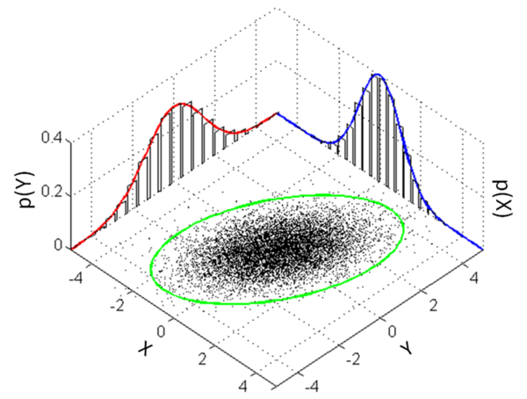
The mean and covariance define a multivariate Gaussian probability distribution.
Credit: wikimedia

Slide 8
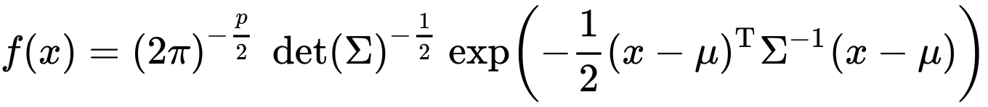
The multivariate Gaussian has a normalized probability density:
Normalization so that PDF integrates to unity
Squared distance to center accounting for covariance
Inverse covariance matrix
(i.e. the precision matrix)
Problem: high-dimensional covariances may be nearly singular.
Credit: wikimedia

Slide 9
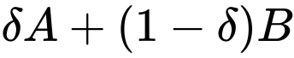
Solution: Condition the sample covariance to make it nonsingular.
A common method is shrinkage regularization:
A small coefficient
To control the amount of regularization
Original sample covariance
Shrinkage target, e.g. identity matrix
Credit: wikimedia

Slide 10
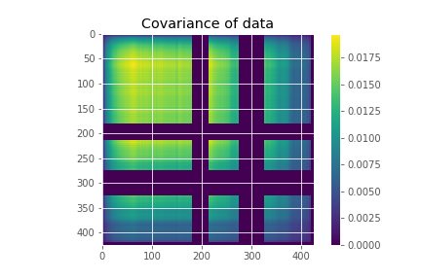
Interpreting covariances can be difficult.

Slide 11
Visualization strategy 1: Plot the “marginals”
The square root of the covariance diagonal, i.e the standard deviation of all channels taken independently, can be used for error bars.

Slide 12
Visualization strategy 1: Plot the “marginals”
However, if we sample from this distribution (each wavelength independently, ignoring correlations), it doesn’t look like a spectrum.

Slide 13
Visualization strategy 2: Draw samples from the multivariate Gaussian.
This produces realistic-looking spectra. Correlations are critical for describing spectral variability.

Slide 15
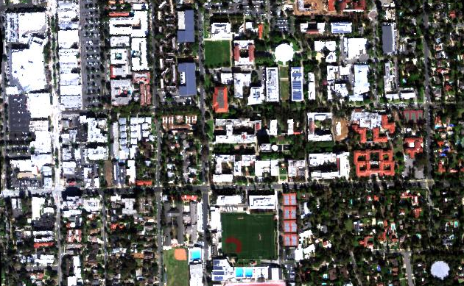
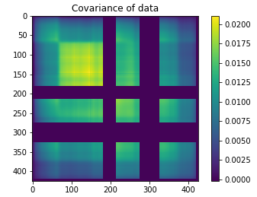
Exercise 3: Fit and sample from covariance matrices.
N
100 m
Objective: Calculate mean spectra and the covariance matrix for the Caltech data cube. Watch out for deep water features and bad data flags (values of -9999) at the periphery. You may not need all spectra in the calculation.
Draw samples from the marginal and full multivariate distributions.
Explore using subsets of the data to create more realistic statistical models for your spectra.

